Slide 1
E-Commerce website for motorcycle safety riding gears
Team Members:
Anudeep Krishnareddy
Prajwal Shivapurmath
Ranjitha Narayana
Sachin Suresh

Slide 2
Agenda
Introduction
Problem Statement
Objective
Snapshots

Slide 3
Introduction:
Ecommerce Website where several user and customers can view and order our products from the their homes with easy of use.
The phenomena that world is fast shrinking into a Global Village because of Internet and other communication mediums is not completely reflective in the Indian context. Internet has brought nearly the entire world just a click away from us. The retail industry canvass has been repainted by Internet and the rules of the game in retailing are fast changing.
Objective:
To Provide motorcyclist with uncompromised safety . which in turn help company leverage the open market to increase profitability and sales.

Slide 4
Problem Statement
Over half Indian motorcyclists (57%) admit to not wearing a helmet when on the road, while an even higher proportion of their passengers (74%) neglect to wear one whilst riding pillion. These are amongst the findings of a new study Over half Indian motorcyclists (57%) admit to not wearing a helmet when on the road, while an even higher proportion of their passengers (74%) neglect to wear one whilst riding pillion. These are amongst the findings of a new study published by Exide Life Insurance, revealing the startling and dangerous practices of the country's motorcycle riding community.
According to the research, riders are basing their decision to ride helmetless for a range of reasons; 13% due to the cost of a helmet, 16% believe that they are not required to by the law, 21% simply ride bare-headed due to a force of habit revealing the startling and dangerous practices of the country's motorcycle riding community. According to the research, riders are basing their decision to ride helmetless for a range of reasons; 13% due to the cost of a helmet, 16% believe that they are not required to by the law, 21% simply ride bare-headed due to a force of habit.

Slide 5
Products we Offer
1.Helmates:
2. Motorcycle Jackets:
3.Riding Gloves
4.Motorcycle Boots
5.Pants
6.Thermals
Current Strategy and implementation:
We offer the best in class and wide range of products to our customers that are suite the specific needs .
We have our research team that are relentlessly innovating and finding new ways to improve our offerings and set a standard in market.

Slide 6
About Us:
We are amongst you all! We ride and do not let go a chance when we see an opportunity to go on short tour (But of late, unfortunately, we are compelled to give a few of them a miss!). MotoGear was in fact born when 3 such passionate riders met; each of them came with their own set of diverse riding preferences, experiences and their favourite riding routes and destinations (which we still quarrel upon like babies when we plan our ride together).
With all the diversities we came with, all of us believed that the Indian market in 2012 did not have quality and practical luggage. Quality luggage was made available in India by most of the international brands but that came at a price, which was not affordable for most of us. Thus, was born MotoGear with a vision to provide quality, reliable luggage at a price we believed most of us were willing to shell out for our rides. We all ride and thus understand the criticality of an equipment failure during a ride.
“Quality is not an act. It is a habit”. This is the exact notion that we follow at MotoGear Gears. As a part of our job, we have made a habit of keeping ourselves updated on raw materials, technology, etc that our Indian and International market has to offer in helping us make a better product for our customers. For us, it has always been quality over price i.e. expand a tad bit to get the right material. This is how we function!

Slide 7
Modules:
Display the products that are available
Products can be added to cart
User can see the product details
Products can be removed from cart one by one or cart can be empty at once
Can be able to order products by entering appropriate payment details
User should be able to login and register new users
Chat window for Customer support
Admin can manage users by creating ,deleting or updating

Slide 8
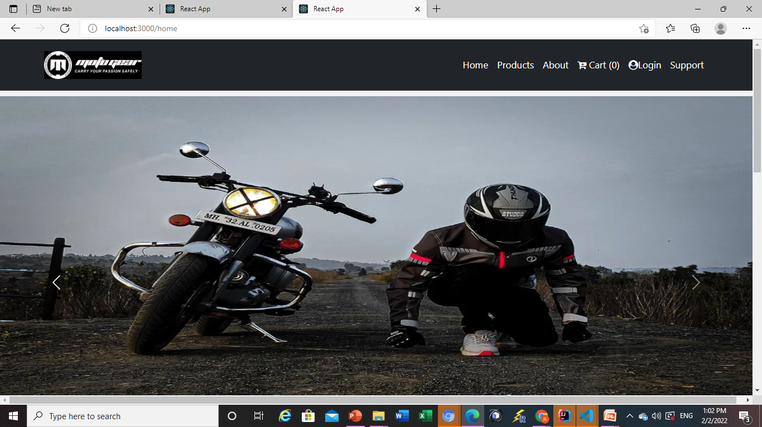
Snapshots
Home Page

Slide 9
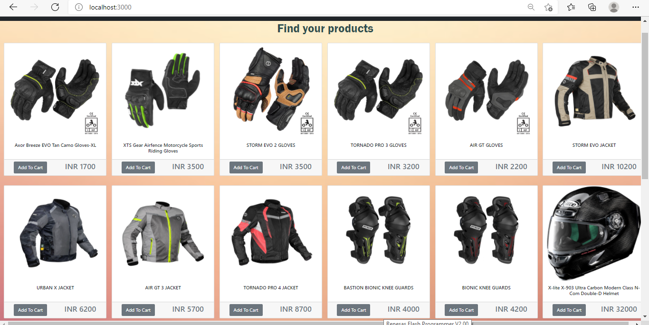
Products Page:

Slide 10
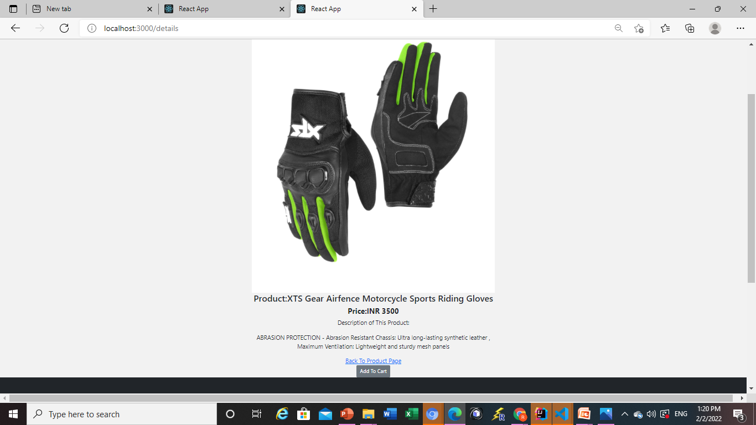
Product Details Page:

Slide 11
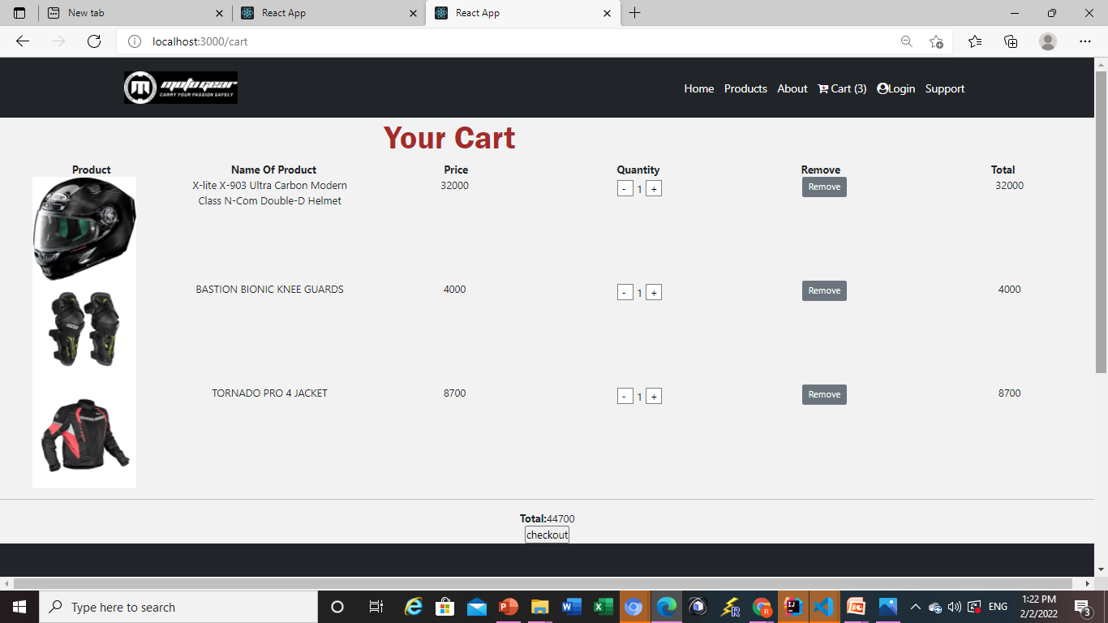
Cart Page:

Slide 12
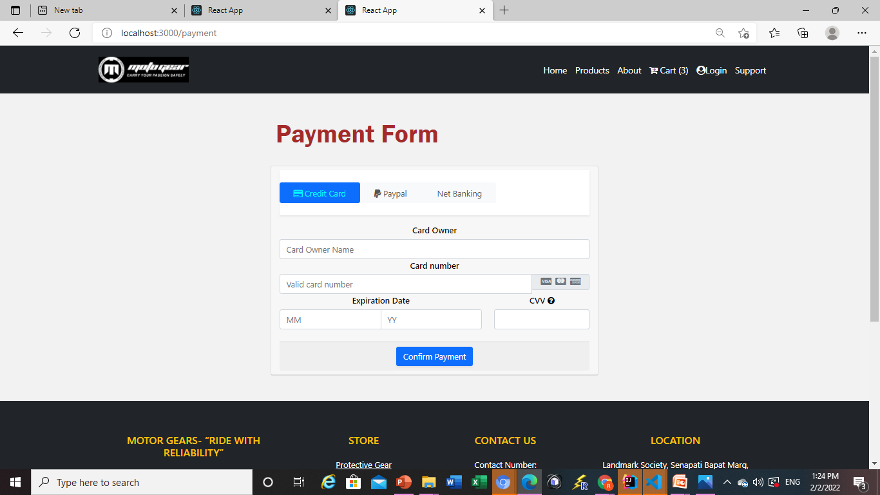
Payment page:

Slide 13
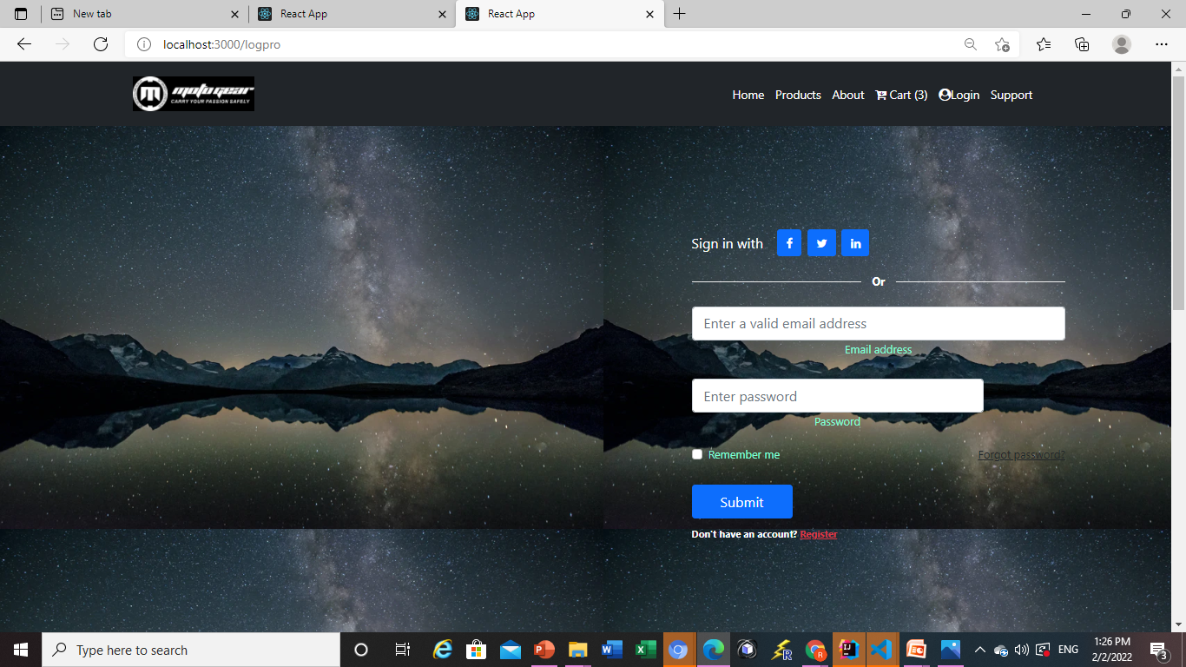
Login Page:

Slide 14
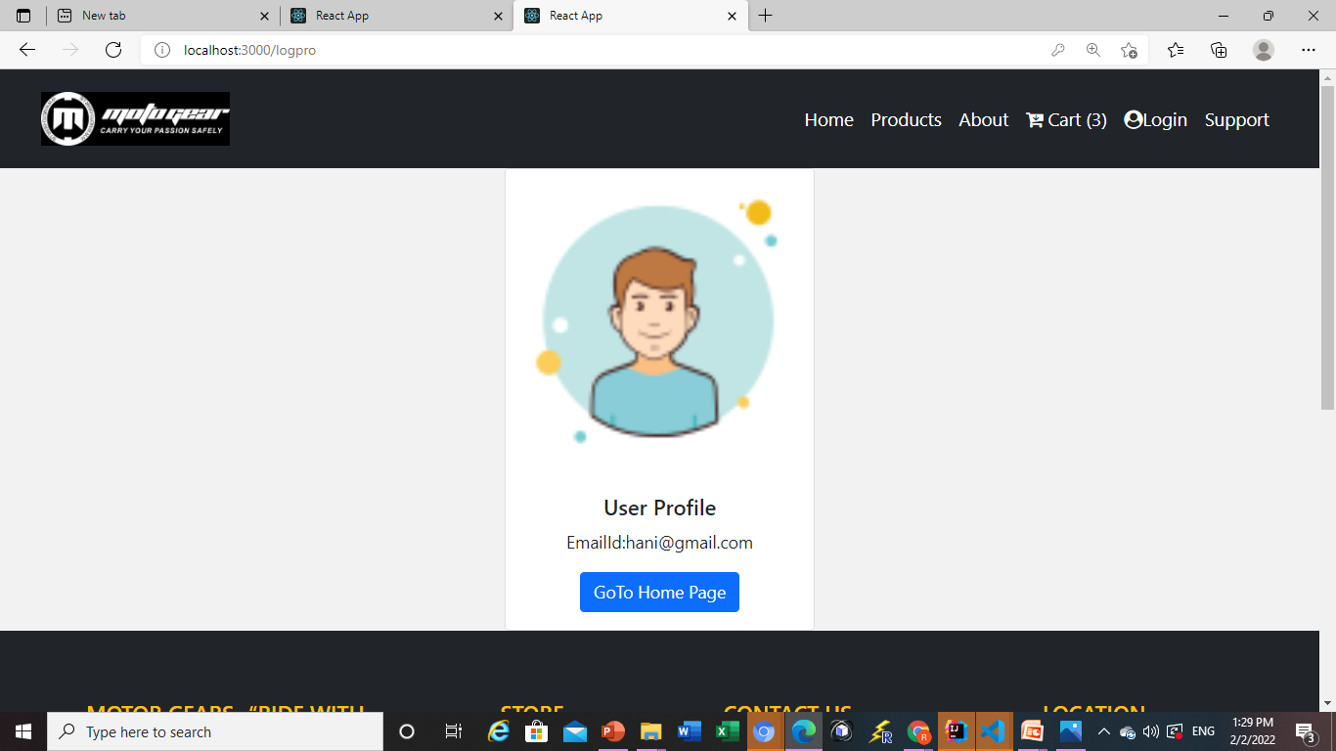
Profile Page After LoggedIn:

Slide 15
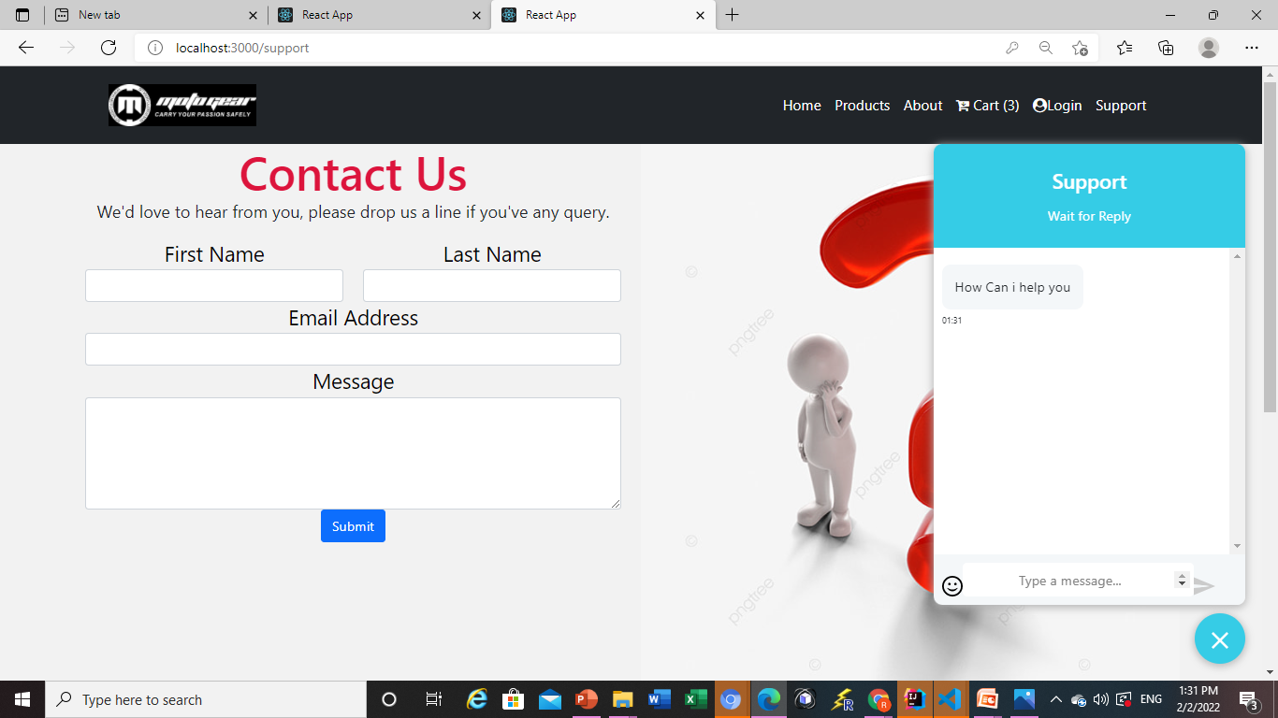
Support Page:

Slide 16
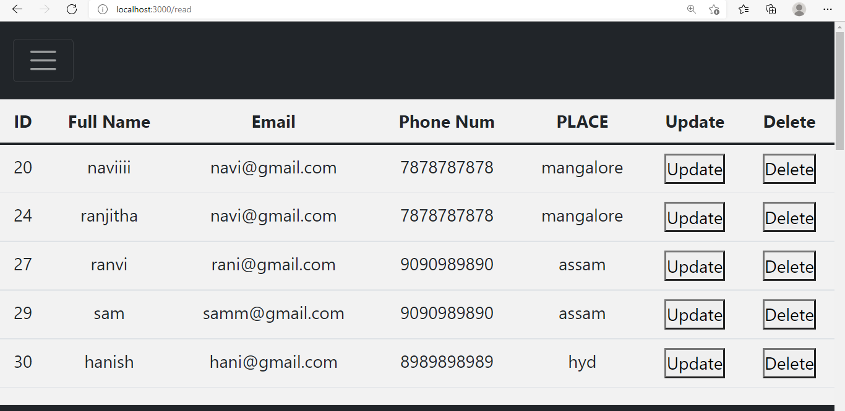
Admin Page:

Slide 17
THANK YOU

